Slide 1


Slide 2


3 / 12
Data Structures And LINQ
By: Mr. Shivam Supekar

Slide 3

Agenda
1
Introduction and Types
2
Arrays And List
3
Dictionary And HashSet
4
Queue And Stack
5
LinkedList And Tuple
6
LINQ
7
Use Cases
8
Assignment
9
Debrief

Slide 4
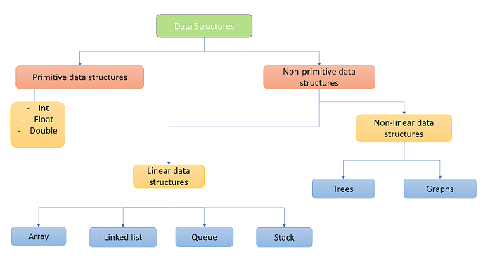
Introduction Of Data Structures
Types of Data Structures in C# :
C# provides two main categories of data structures:

Slide 5
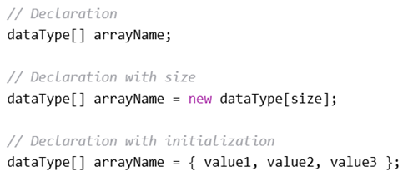
Arrays in C #
What is an Array?
A fixed-size, indexed collection of elements of the same data type
Elements are stored in contiguous memory locations
Accessed using zero-based indexing
📦 Analogy: Like a row of lockers — each locker (index) holds one item (element)
Why Use Arrays?
To group related values under a single variable
To access data quickly using indexes
To store data efficiently in memory
Syntax of Array Declaration

Slide 6
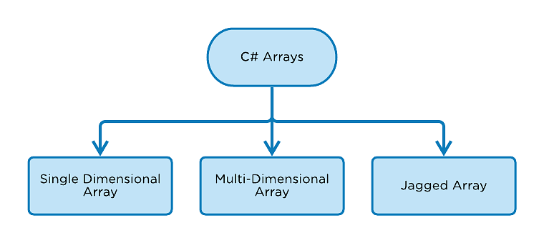

Slide 7
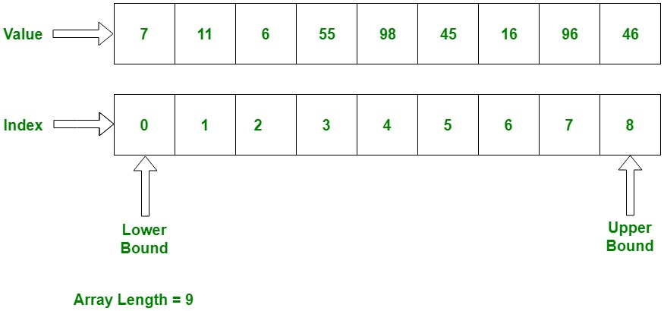

Slide 8
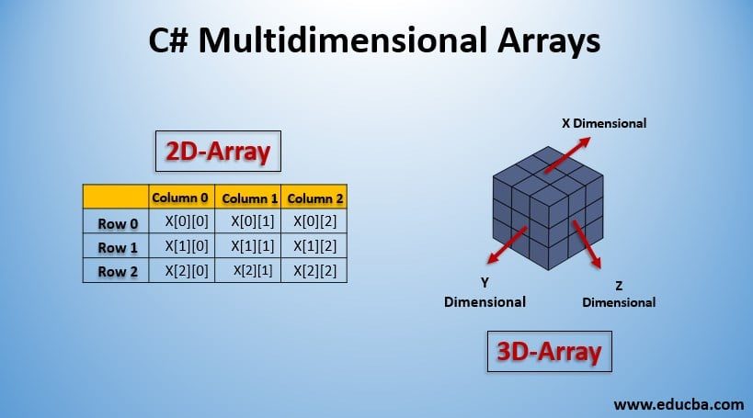

Slide 9
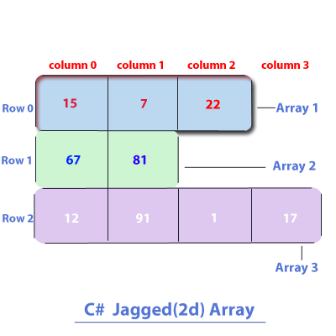

Slide 10
List In C#
What is List<T>?
A generic ,resizable collection from System.Collections.Generic
Stores elements of a specific type(T)
Supports indexing ,dynamic resizing and many built-in methods
Think of it like a smart array that grows automatically
Declaration & Initialization
Adding Elements:

Slide 11
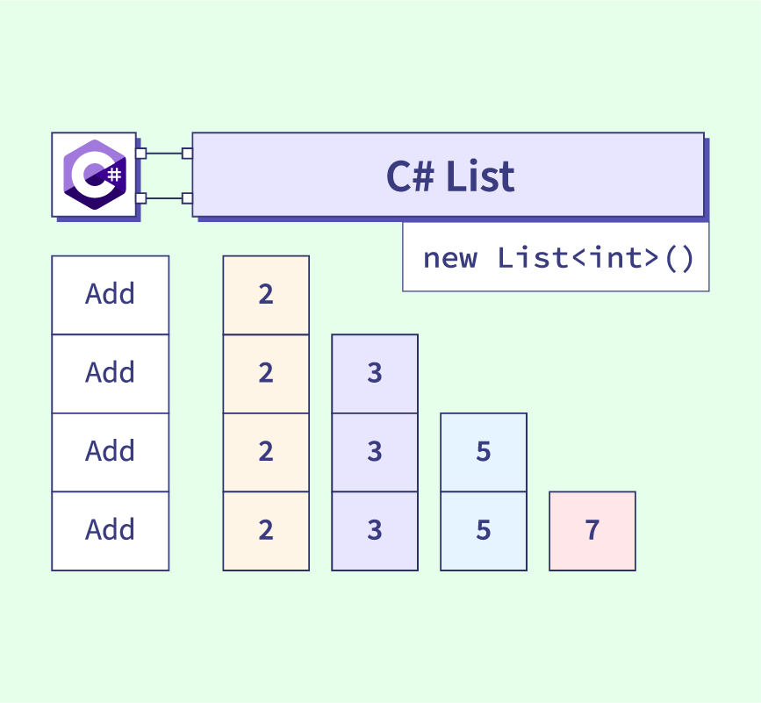

Slide 12
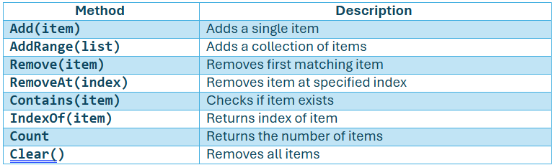
List In C#
Useful Methods :

Slide 13
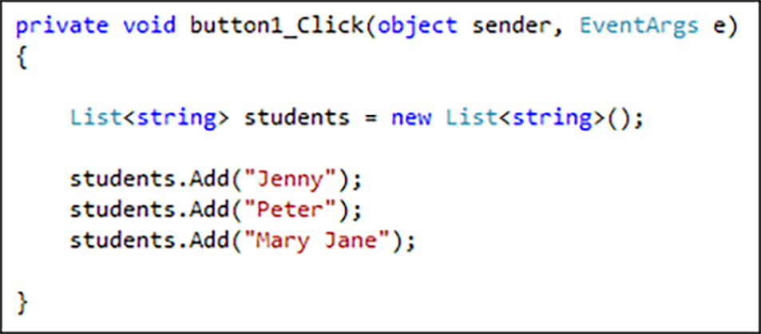
Example of List in C#

Slide 14
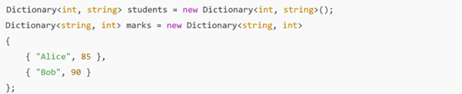
Dictionary in C #
What is a Dictionary?
Dictionary<TKey,TValue> is a collection from the System.Collections.Generic namespace that efficiently stores and manages key-value pairs for the fast lookup, addition and removal based on keys
Why Use Dictionary?
Fast Key-Based Access
Stores Related Data Together
Syntax of Dictionary Declaration :

Slide 15
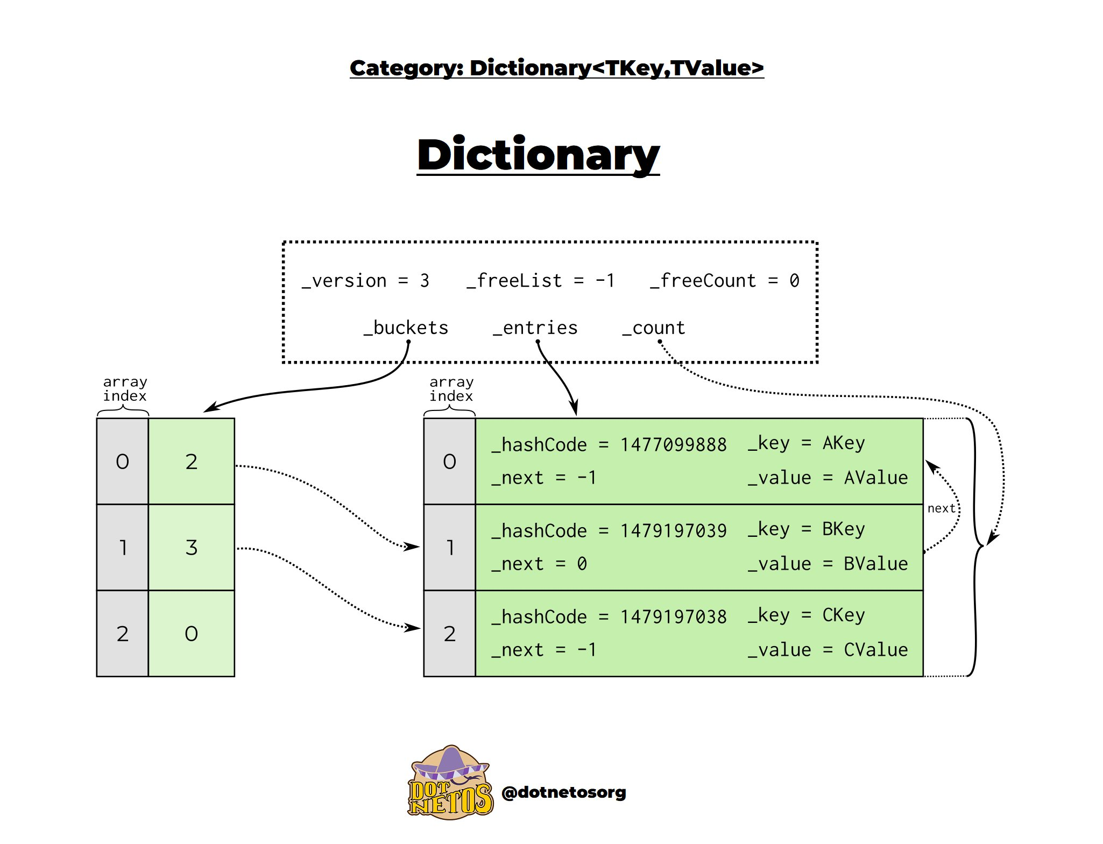

Slide 16
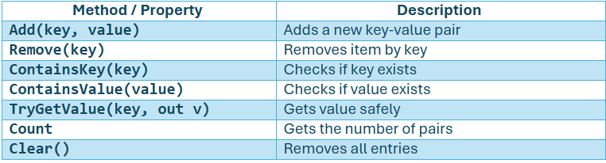
Dictionary In C#
Useful Methods :

Slide 17

HashSet In C#
What is HashSet<T>?
HashSet<T> is a collection of unique values — it automatically removes duplicates and provides fast lookup operations. It is part of the System.Collections.Generic namespace and uses a hashing algorithm to store values efficiently.
Declaration & Initialization

Slide 18
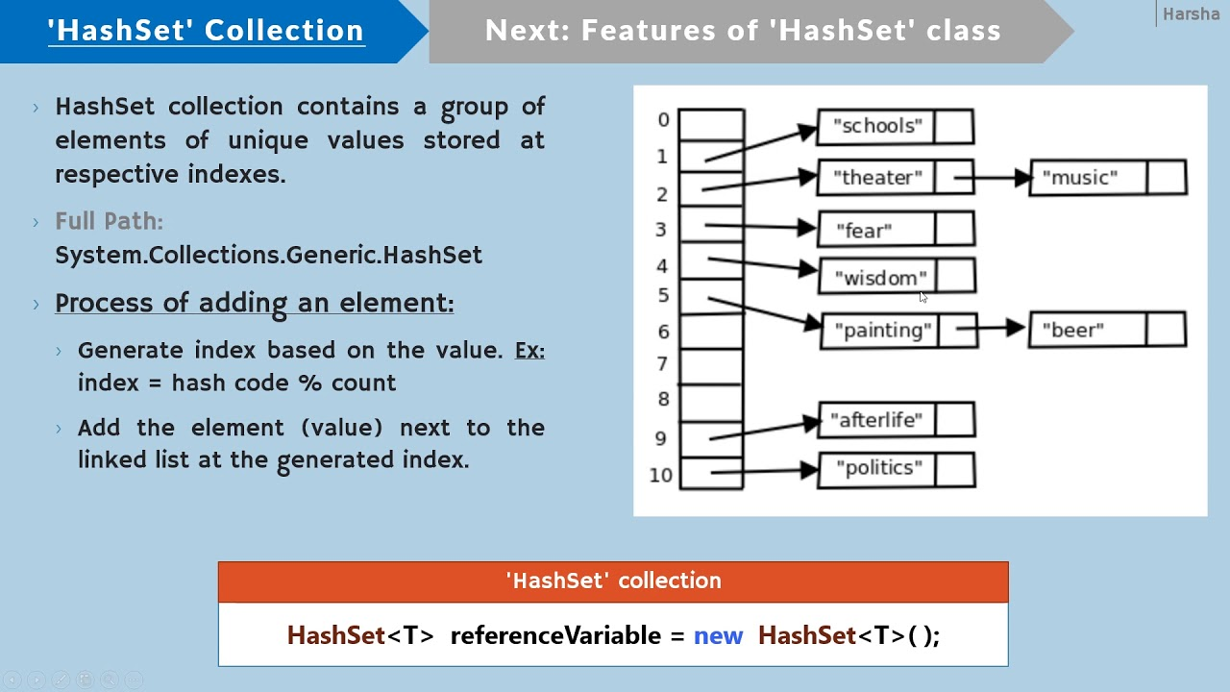

Slide 19
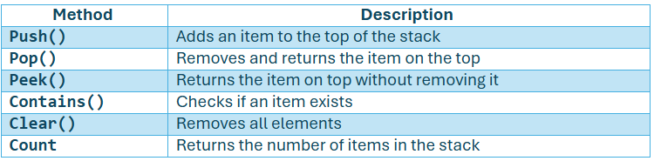
Stack in C #
What is a Stack?
Stack<T> is a Last-In-First-Out (LIFO) collection in C#. This means the last item added is the first one removed, just like stacking and unstacking plates.
Why Use Stacks?
Follows LIFO (Last-In, First-Out) behavior.
No duplicates restriction.
Efficient for operations like Undo, Back navigation, or function call tracking.
No indexing like a list.
Syntax of Stack Declaration
Useful Methods:

Slide 20
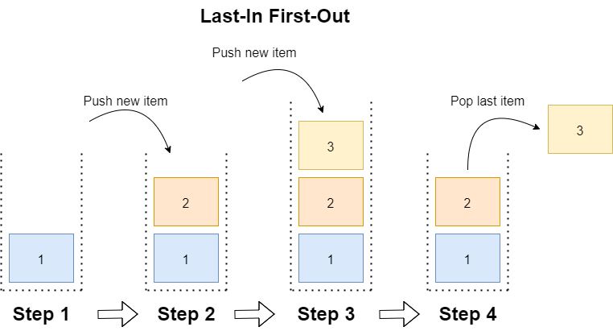

Slide 21
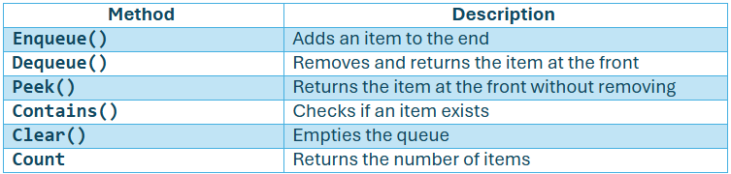
Queue in C #
What is a Queue?
Queue<T> in C# is a First-In-First-Out (FIFO) data structure that stores elements in the order they were added. It's part of the System.Collections.Generic namespace and is commonly used when you need to process items in the order they arrive.
Why Use Queues?
Order Matters (FIFO)
Great for Sequential Tasks
Syntax of Queue Declaration
Useful Methods:

Slide 22
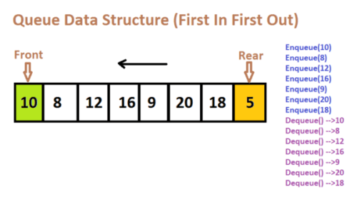

Slide 23
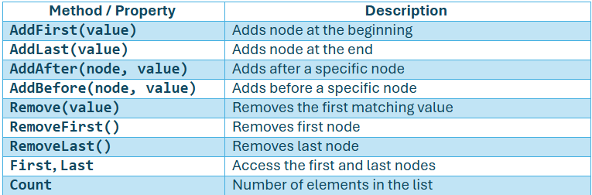
LinkedList in C #
What is a LinkedList?
LinkedList<T> is a doubly-linked list where each node points to both next and previous nodes. It's useful for efficient insertions and deletions at the beginning ,end or middle of the list.
Key Features
Doubly linked (each node links to the next and previous).
Allows fast insertion/removal from any position.
No indexing like an array or list.
Can be traversed forward and backward.
Syntax of Queue Declaration
Useful Methods:

Slide 24
LinkedList in C #
Important point:
C# does not provide a built-in singly linked list class (only a doubly linked list via LinkedList<T>).
So, if you want a singly linked list, you usually implement it manually using classes.
OR
But can we use LinkedList<T> like a singly linked list?
Yes,
If you just ignore the .Previous property and only use .Next to move forward, you are essentially traversing like a singly linked list.

Slide 25
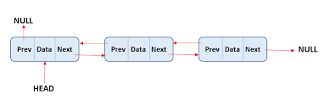

Slide 26

Tuple in C #
What is a Tuple?
Tuple lets you group multiple values into a single object – ideal for returning multiple values from a method without creating a custom class.
Key Features
Can store multiple values of different types.
Immutable (values can't be changed after creation).
Supports up to 8 items (for more, use nesting).
Creating Tuples :
or explicitly

Slide 27
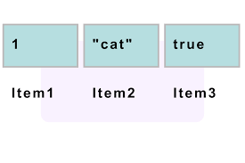
Example of Tuple Structure

Slide 28
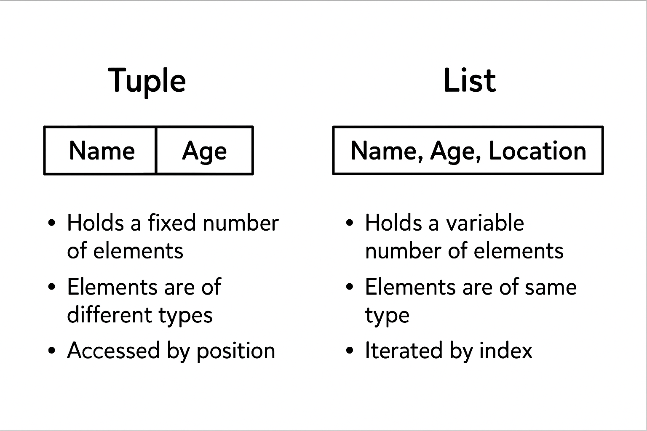
Difference between Tuple and List

Slide 29
LINQ
What is LINQ in .NET?
LINQ (Language Integrated Query) is a powerful feature in .NET that allows querying collections, databases, XML, and more using C# syntax — bringing SQL-like querying directly into the language.
Why Use LINQ?
Readable, Declarative Code
Write clean, SQL-style queries in C#.
Works Across Data Sources
Use LINQ with Lists, Databases (EF), XML, JSON, etc.

Slide 30
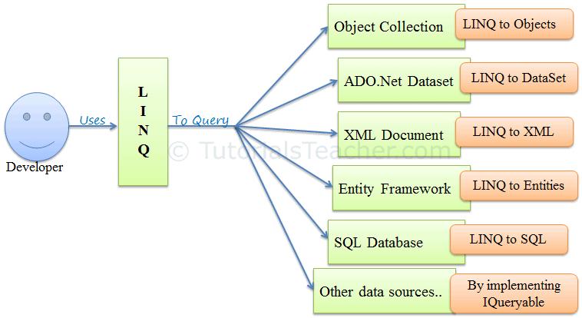

Slide 31
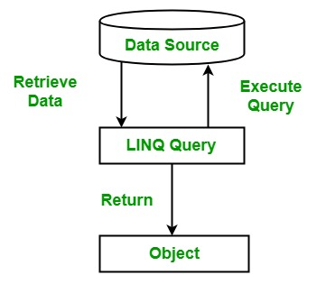

Slide 32
Common LINQ Methods
Method | Purpose
Where() | Filter items
Select() | Transform data
OrderBy() | Sort ascending
GroupBy() | Group by key
Join() | Merge two collections
First(), FirstOrDefault() | Get first match
Any() / All() | Check if conditions are met
ToList() | Convert query result into a list

Slide 33
Use Cases
Data Structure/Topic | Use cases
Array | Fixed-size collections like monthly sales, sensor readings, or static lookup tables
List<T> | Dynamic lists such as shopping carts, user inputs, or paginated data
Dictionary<TKey, TValue> | Fast lookups like mapping user IDs to profiles, config settings, or caching
HashSet<T> | Avoiding duplicates — e.g., tracking visited pages, unique tags, or email addresses
Queue<T> | First-In-First-Out tasks — e.g., background jobs, ticketing systems, print queues
Stack<T> | Last-In-First-Out tasks — e.g., undo operations, back navigation, expression parsing
LinkedList<T> | Fast insert/delete in the middle — e.g., music playlists, real-time task scheduling
Tuple | Returning multiple values from methods without creating a class — e.g., (name, score), (status, message)
LINQ | Querying data collections — e.g., filtering orders, projecting customer lists, grouping transactions

Slide 34

Assignment
1.) Student Grades – Arrays, Lists & LINQ
Objective: Use arrays, lists, and LINQ to process student data.
Tasks:
Create a student class with :
Properties: Name , Roll Number , Marks(int[] of 5 subjects)
In Main():
Create a List<Student> and add at least 5 students with marks
For each student:
Calculate total and average marks using LINQ.
Display highest and lowest scoring student using LINQ

Slide 35
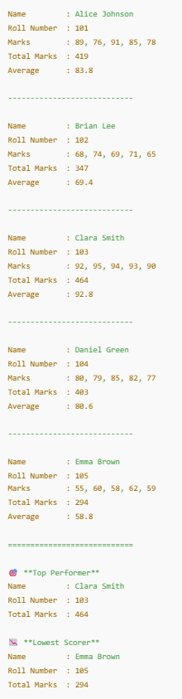
Assignment
Output Format :

Slide 36
Assignment
2.) Library Management – Dictionary, HashSet, LinkedList
🎯 Objective: Use dictionaries and collections to manage book inventory.
🔧 Tasks:
Use a Dictionary<int, string> to store book ID and title.
Use a HashSet<string> to track issued book titles (to prevent duplicates).
Use LinkedList<string> to manage the borrow queue.

Slide 37
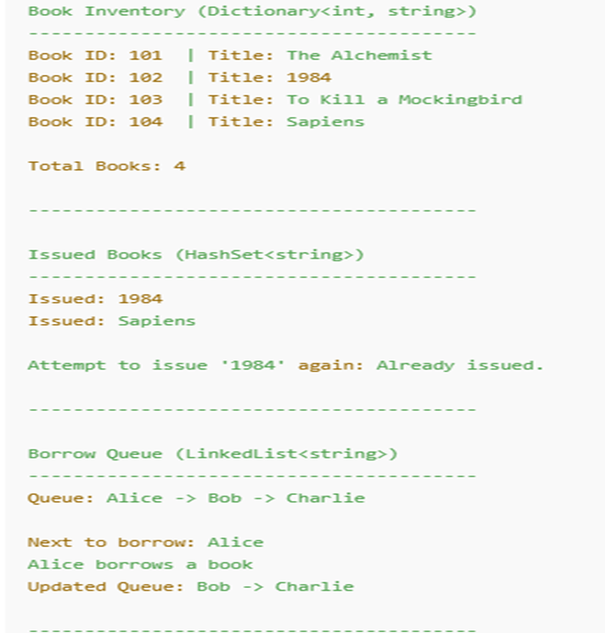
Assignment
Output Format :

Slide 38
Assignment
3)LINQ – Advanced Student Analytics
🎯 Objective: Perform advanced LINQ queries on student data.
🔧 Tasks:
Create a student class :
Name, RollNumber,Marks (Dictionary<string,int> →subject, mark)
In Main() :
Add 5 students with marks for 32 subjects.
Use LINQ to :
Find students scoring above 85 in all subjects.
Find the average mark per subject across all students.
Get the top scorer per subject.

Slide 39
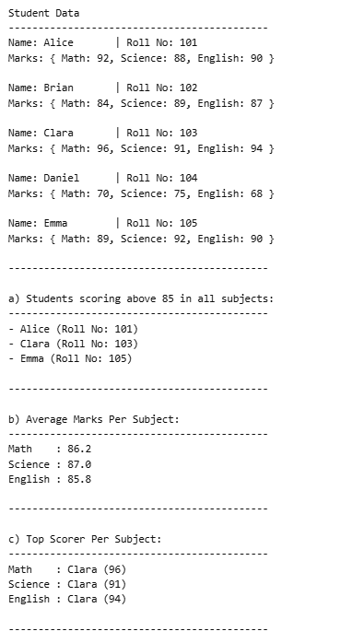
Assignment
Output Format :

Slide 40
4.) LINQ – Employee Department Join
🎯 Objective: Use join, group join and aggregate queries.
🔧 Tasks:
Create a student class with :
Employee Class : Id,Name,Department ,Salary
Department class :Id, DeptName
In Main():
Add sample employees and departments.
Use LINQ to:
Join employees with their department names.
Group employees by department and calculate:
Average salary
Count of employees per department
Find department(s) with the highest average salary.
Assignment

Slide 41
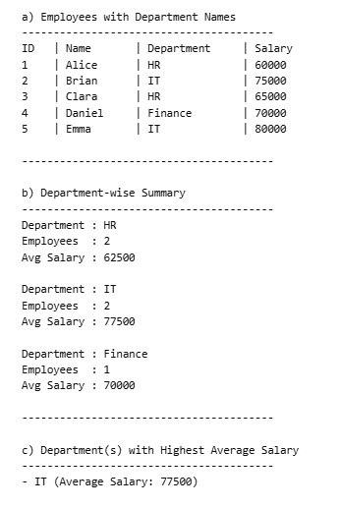
Assignment
Output Format :

Slide 42

+
+
+
+
LEVEL
Stretch Goals
+
UP
+
+
LINQ – Product Sales Report
Objective: Combine filtering, ordering, and grouping with LINQ
Tasks:
Create a ProductSale class:
ProductName, Category, UnitsSold, UnitPrice
In Main():
Add at least 10 product sales records across 3 categories.
Use LINQ to:
Group by category and find:
Total revenue per category
Best-selling product per category
List top 3 products by total revenue.
Filter products with revenue > 1000 and order by revenue descending

Slide 43
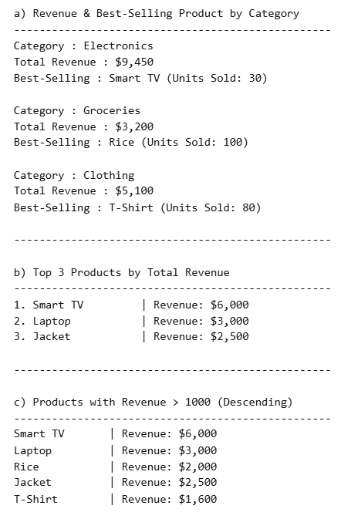
Assignment
Output Format :

Slide 44
Debrief
Array and List
Dictionary and HashSet
Queue and Stack
LinkedList and Tuple
LINQ
Use cases

Slide 45
📘 Official Resources (High-Quality & Up-to-Date)
References
https://learn.microsoft.com/en-us/dotnet/csharp/
https://www.tutorialsteacher.com/csharp/csharp-collections

Slide 46
Thank you

